Slide 1

Intermediate ASP.NET MVC
Joe Wilson, President
Volare Systems, Inc.
Email: joe@volaresystems.com
Office: 303-532-5838, ext 101
Web: http://VolareSystems.com
Blog: http://VolareSystems.com/Blog
Twitter: joe_in_denver

Slide 2
Agenda
Quick MVC review
Discussion on application design best practices
Code!
“Real-world” development sample
Routing
Testing
Returning JSON from controller to view
Error handling

Slide 3

MVC Request/Response Pipeline
Request (GET or POST)
Routing Engine
Controller (Action)
Response
View,
JSON, File,
XML, RSS
Model

Slide 4
Application Design
Request
Response
UI
Layer
Controller
View
Application Layer
Application Services
View Model
Domain Model
Repositories
Utilities

Slide 5
Code!

Slide 6
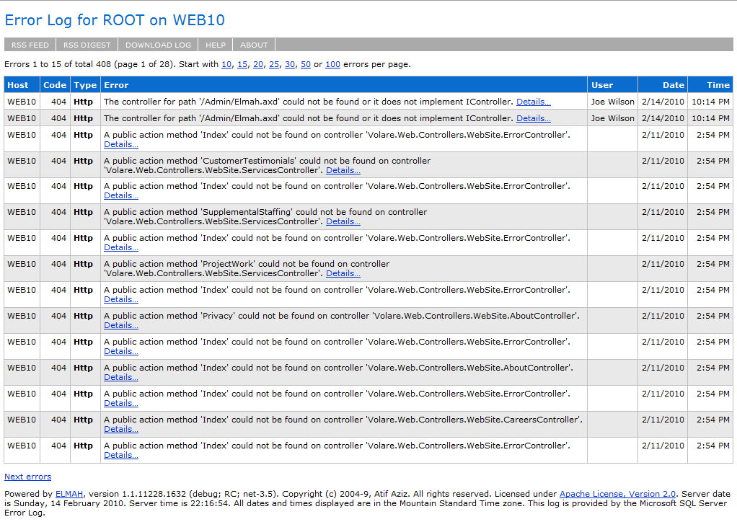
Elmah Results

Slide 7
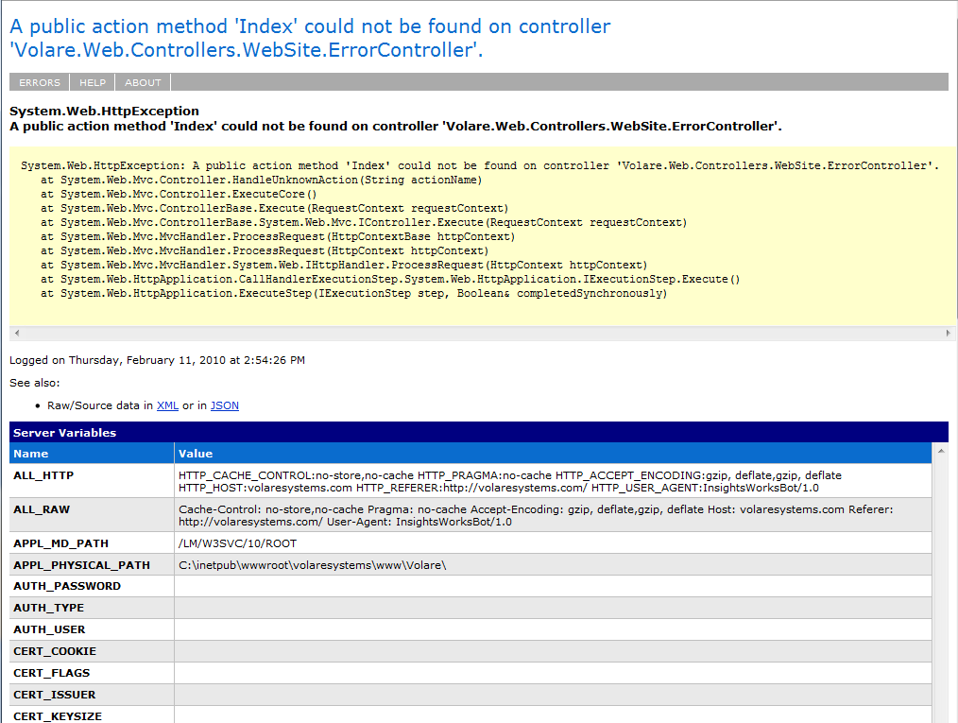
Elmah Results

Slide 8
Resources
Learning ASP.NET MVC
ASP.NET MVC official site - http://www.asp.net/mvc
Community Four MVC - http://www.c4mvc.net
Keeping up with changes to ASP.NET MVC
Phil Haack’s Blog - http://haacked.com
Scott Guthrie’s Blog - http://weblogs.asp.net/scottgu
Advanced ASP.NET MVC
Sharp Architecture - http://sharparchitecture.net
Eric Hexter’s Blog - http://lostechies.com/blogs/hex
Jimmy Bogard’s Blog - http://lostechies.com/blogs/jimmy_bogard
Email: joe@volaresystems.com
Office: 303-532-5838, ext 101
Web: http://VolareSystems.com
Blog: http://VolareSystems.com/Blog
Twitter: joe_in_denver

